Slide 1
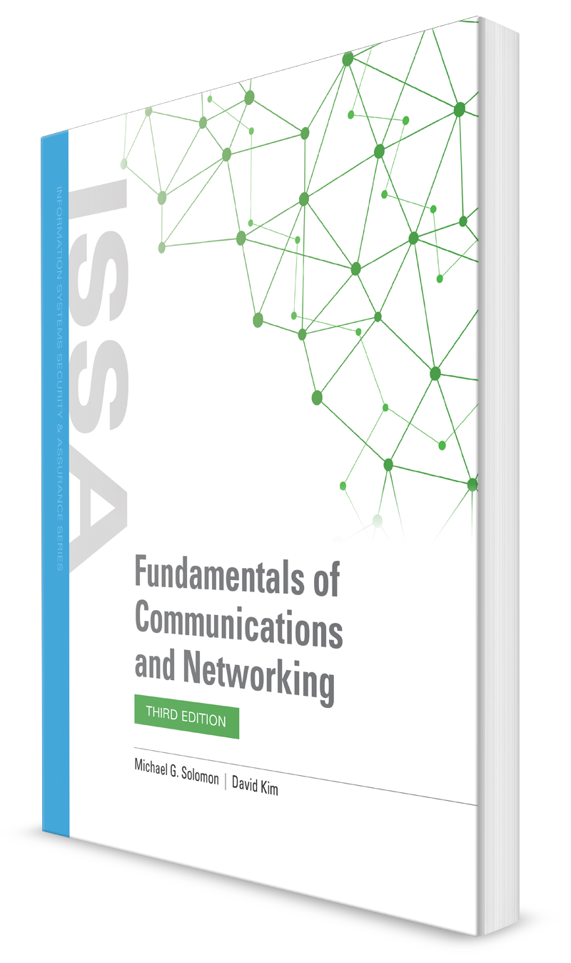
Circuit-Switched, Packet-Switched, and IP-Based Communications
CHAPTER 3

Slide 2
Learning Objective(s) and Key Concepts
Learning Objective(s)
Key Concepts
Examine the TCP/IP protocol family and how IP is used to support voice, video, data, and Internet communications.
The OSI and TCP/IP Reference Models
TCP/IP suite
Network topologies
Circuit and packet switching
IP-based communications and convergence

Slide 3
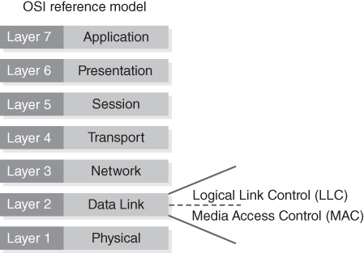
Open Systems Interconnection Reference Model
Defines and abstracts network communications
Logical layers based on communication function
Hosts interact on same layer
FIGURE 3-2 OSI Reference Model.
Notes:
Created in the 1970s
Created as a new communication standard
Why is it important? → helps with troubleshooting (what layer problem is it?)

Slide 4
OSI Reference Model Layers with Protocols, Applications, and Devices (1 of 2)
OSI Reference Model Layer | Common Protocols and Applications | Common Devices
Application | BitTorrent, DNC, DSNP, DHCP, FTP, HTTP(S), IMAP, MIME, NNTP, NTP, POP3, RADIUS, RDP, SMTP, SOAP, Telnet | Gateway, firewall, endpoint device (server, PC, mobile device, etc.)
Presentation | AFP, SSL, TLS | Gateway, firewall, server, PC
Session | L2F, L2TP, NetBIOS, NFS, RPC, SMB, SSH | Gateway, firewall, server, PC
Transport | AH (over IP/IPSec), BGP, ESP (over IP/IPSec), TCP, UDP, SPX | Gateway, firewall
Notes:
SSH instead of Telnet
TCP – layer 4
IP – layer 3

Slide 5
OSI Reference Model Layers with Protocols, Applications, and Devices (2 of 2)
OSI Reference Model Layer | Common Protocols and Applications | Common Devices
Network | ICMP, IGMP, IGRP, IPv4, IPv6, IPSec, IPX, GRE, OSPF, RIP | Router, brouter, Layer 3 switch
Data Link | ARP, Ethernet (IEEE 802.3), FDDI, Frame Relay, IND, L2TP, PPP, MAC, NPD, RARP, STP, Token Ring, VLAN, Wi-Fi (IEEE 802.11), WiMax (IEEE 802.16), X.25 | Bridge, modem, network card, Layer 2 switch
Physical | Bluetooth, DSL, Ethernet (Physical Layer), USB, Wi-Fi (Physical Layer) | Hub, repeater, cable, fiber, wireless

Slide 6
OSI Reference Model Layers
Application Layer
This is responsible for interacting with end users.
The Application Layer includes all programs on a computer that interact with the network;
User interface
Presentation Layer
This is responsible for the coding of data.
The Presentation Layer includes file formats and character representations.
From a security perspective, encryption generally takes place at the Presentation Layer.

Slide 7
OSI Reference Model Layers
Session Layer
This is responsible for maintaining communication sessions between computers.
The Session Layer creates, maintains, and disconnects communications that take place between processes over the network.
Transport Layer
This is responsible for breaking data into packets and properly transmitting them over the network.
Flow control and error checking take place at the Transport Layer.

Slide 8
OSI Reference Model Layers
Network Layer
This is responsible for the logical implementation of the network.
One important feature of the Network Layer, covered later in this chapter, is logical addressing.
Router
Data Link Layer
This is responsible for transmitting information on computers connected to the same local area network (LAN).
The Data Link Layer uses Media Access Control (MAC) addresses. Device manufacturers assign each hardware device a unique MAC address.
Switch

Slide 9
OSI Reference Model Layers
Physical Layer
This is responsible for the physical operation of the network.
The Physical Layer must translate the binary ones and zeros of computer language into the language of the transport medium.
In the case of copper network cables, it must translate computer data into electrical pulses.
In the case of fiber optics, it must translate the data into bursts of light.

Slide 10
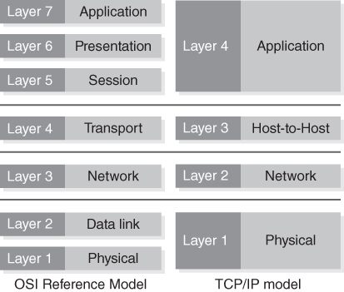
TCP/IP Reference Model
Represents the same functionality as the OSI model, but several layers are combined
Maps well to the TCP/IP protocol suite
Describes how the Internet Protocol suite operates
FIGURE 3-3 A comparison of the TCP/IP and OSI models.
Notes:
OSI reference model – published as a prescriptive model
TCP/IP model – descriptive model
Started in the military

Slide 11
TCP/IP Reference Model Layers
Application Layer
Interacts with applications that need to gain access to network services
Transport Layer
Segments the data and adds a checksum to properly validate data to ensure that it has not been corrupted
Internet Layer
Handles the routing of packets as they move around the network
Network Access Layer
Point at which the higher-layer protocols interface with the network transport media
Notes:
Application: DHCP, HTTP, IMAP, FTP, POP, SIP (most visible)
Transport: Data arrives in same state in which it was sent, missing data is retransmitted, duplicate data is dropped, data is in the correct order, network path problems handled – TCP and UDP
Internet: IP and protocols that support it – ICMP, IPSec
Network access: ARP, L2TP, PPP, MAC

Slide 12
TCP/IP Suite
Provides all of the protocols necessary for applications to exchange messages and data using IP-based networks
Supports communication across networks ranging from small LANs to the Internet
TCP/IP family of protocols facilitate voice, video, data transfer, and Internet communications between devices located anywhere in the world
Nearly all Internet-capable operating systems and devices provide support for the protocols defined in the TCP/IP suite

Slide 13
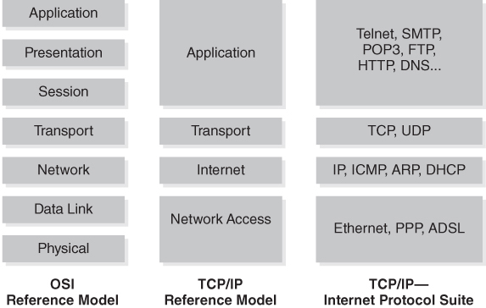
The Main Protocols of the TCP/IP Suite in Relation to the Layers of the Two Reference Models
FIGURE 3-4 The main protocols of the TCP/IP suite in relation to the layers of the two reference models.

Slide 14
Circuit Switching Versus Packet Switching
Circuit-switched network
Packet-switched network
Separates messages into smaller, manageable-sized chunks called packets
Types of Switched Networks
Two devices use the same path, or circuit, throughout a conversation
Example: Plain old telephone service (POTS)
Software applications may choose to use different packet sizes even when using the same protocol
Notes:
Analog signals – POTS and PSTN

Slide 15
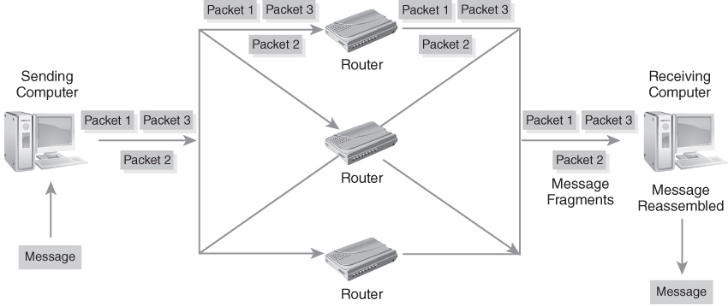
Circuit-Switched Network
FIGURE 3-5 Circuit-switched network.
Notes:
Packets travel in one path (complete message for integrity, little overhead in sending messages so real-time communication w/o delays)
Disadvantages: expensive, fewer users can access available circuits

Slide 16
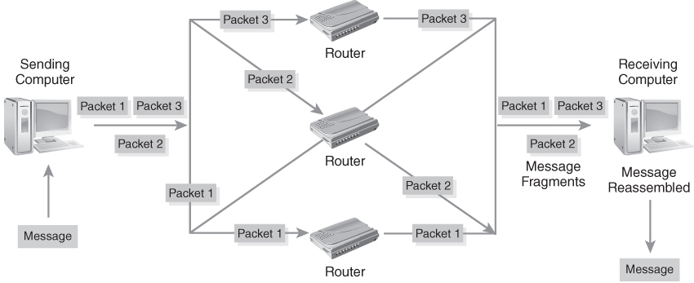
Packet-Switched Network
FIGURE 3-6 Packet-switched network.
Notes:
Packets use multiple paths (examines packet destination MAC and selects best outbound port, receiver reassembles packets to construct the full message) – more scalable
Disadvantage: higher transmission delay/latency
To transform packets into messages:
Resequence out of order packets
Identify missing packets and request resends
Reassmble the complete message

Slide 17
IP-Based Communications (1 of 2)
Transmission Control Protocol (TCP)
Guarantees the delivery of a reliable stream of data between two computer programs
Internet Protocol (IP)
Makes it possible to deliver packets across a complex network to a destination
One of the most popular protocols that organizations use to communicate on the Internet
Operates at OSI Layer 4
Handles the routing decisions necessary to get packets from their source to the destination
Operates at OSI Layer 3
Notes:
IP – TCP, UDP, ATP, SCTP, NFP, FCP
Network presence is expressed as an IP address – identifies a device as a unique node
TCP – syn, syn/ack, ack
UDP – connection-less protocol (not guaranteed, it’s up to destination to receive the whole message)

Slide 18
IP-Based Communications (2 of 2)
Applications are designed and built knowing that TCP/IP is the transport protocol of choice
Standard is so prevalent that network presence is often expressed as an IP address
If you have an IP address, you’re on the network
IP address identifies a device or computer to a network as a unique node
Private IP addresses identify nodes within an organization
Applications that want to communicate over networks only need to reference the IP address of the destination node
Notes:
Results in lower TCO (total cost of ownership)
Advantages: paradigm shift from circuit-switched voice communications to IP-based communications
Collaboration: online app that allows multiple users to share and view the same info on a master computer or controller
Between two IP addresses are routers and switches routing the traffics

Slide 19
Network Topology Overview
Network topology
The layout of how devices connect to a network
A map of the network that shows how devices connect to one another and how they use a connection medium to communicate
A node (server, computer, smartphone, etc.) can physically connect to the network and has an assigned IP host address
Physical topology
The picture of the actual network devices and the medium the devices use to connect to the network
Logical topology
How the actual network works and how you transfer data in a network; view focuses more on how the network topology operates

Slide 20
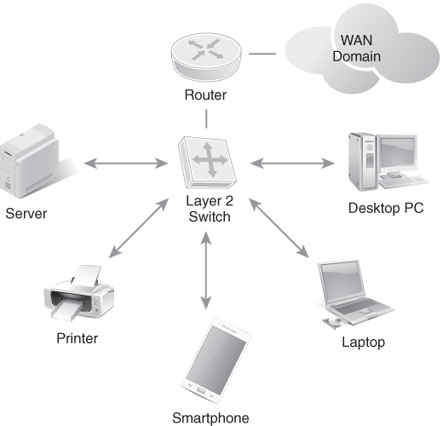
Simple Network Diagram
FIGURE 3-7 Simple network diagram.
Notes:
Router puts the traffic on the Internet
Before your traffic gets to the Internet, it has to go to the router to help you get there
It resides on Layer 3 (cannot get on the Internet without this layer)

Slide 21
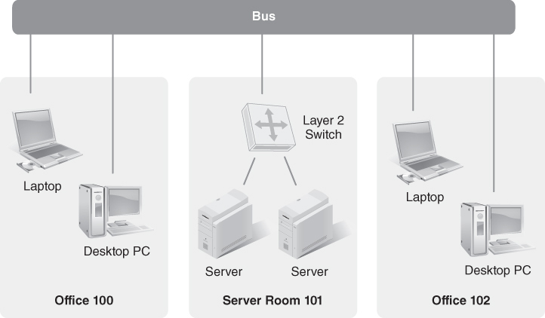
Physical Network Topology
FIGURE 3-9 Physical network topology.

Slide 22
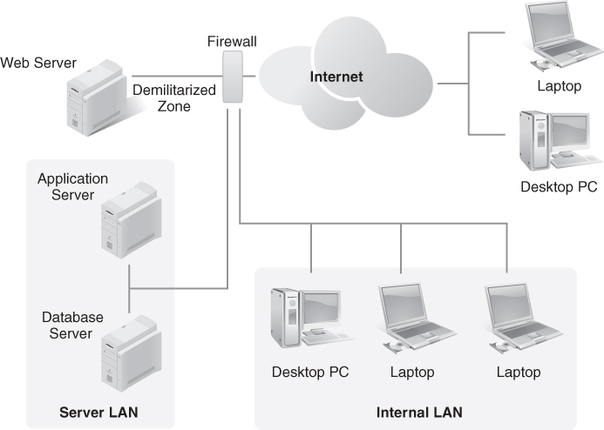
Logical Network Topology
FIGURE 3-10 Logical network topology.

Slide 23
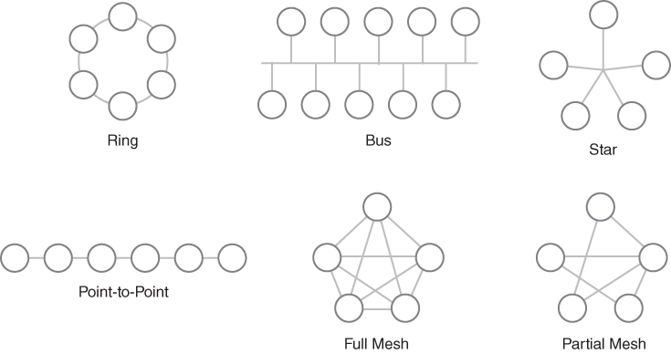
Common Network Topologies
FIGURE 3-11 Common network topologies.
Notes:
Ring—A shared ring connecting multiple devices together
Bus—A shared network transmission medium allowing only one device to communicate at a single time
Star—A star-wired connection aggregation point, typically from a wiring closet (like a cable modem)
Point-to-point—A direct link or connection between two devices
Mesh—Multipoint connections and direct links between network devices
Hybrid/star-wired bus—Also known as a tree topology; a shared, star-wired connection aggregation point to a LAN switch

Slide 24
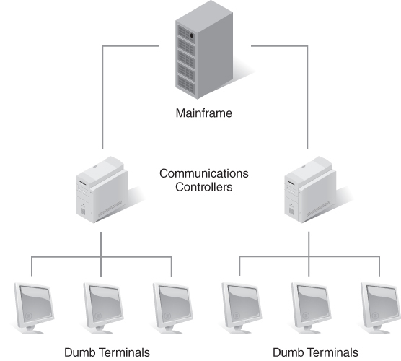
Point-to-Point Networks
Networks that consist of computers or devices that connect directly to one another
Difficult to add many devices because each new device requires a direct connection
Found in very small environments that only need to connect a few PCs
Are considered archaic
FIGURE 3-12 Point-to-point topology with legacy mainframe computers.
Notes:
Legacy – host-based systems, central computer w/ many users connected directly to it, used terminal to access central computer
Terminal – device that has a keyboard + monitor that can input data to central computer
Dumb terminals – terminals that’d send and receive characters to/from central computer
Serial communications – terminal would do the dumb terminal in a serial fashion

Slide 25
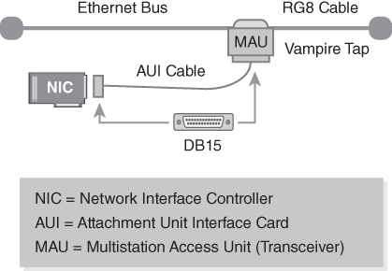
Bus Topology (1 of 2)
Coaxial cable (bus) runs throughout a physical space; network devices attach to bus using an Ethernet transceiver
Supports high-speed network communications
Is simple to construct
Is subject to physical distance limitations and maximum number of devices
Only one device can communicate at a given time
FIGURE 3-14 IEEE 802.3a CSMA/CD Ethernet bus topology.

Slide 26
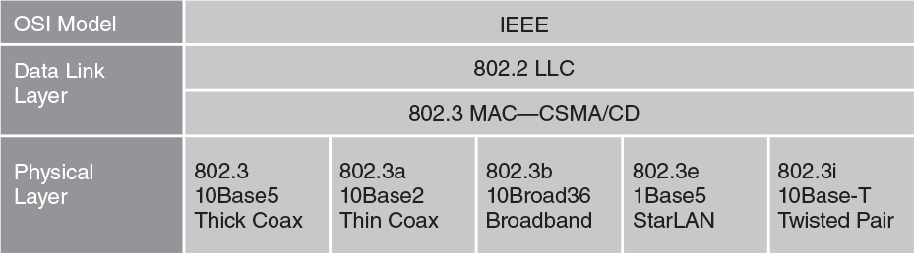
Bus Topology (2 of 2)
When two devices transmit at the same time, a collision occurs on the network
Both devices must retransmit when the network is available
Led to creation of IEEE 802.3 CSMA/CD (Carrier Sense Multiple Access with Collision Detection) and IEEE 802.5 token ring standards for local area networking
FIGURE 3-15 IEEE 802.3 CSMA/CD standards.

Slide 27
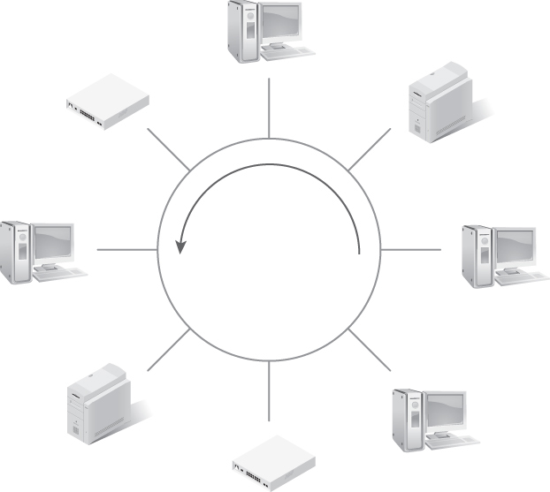
Ring Topology
All stations are connected in a logical ring
Attached devices need permission to transmit on the network
Permission is granted via a token (small frame) that circulates around the ring
Unidirectional manner eliminates network transmission collisions
A cut in the cable will break a ring network
FIGURE 3-16 Token ring network—physical star, logical ring.

Slide 28
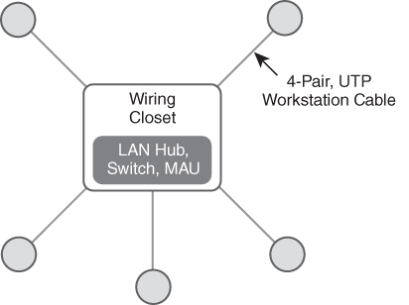
Star Topology
Star-wiring cabling from a centrally located wiring closet creates Ethernet or token ring network
Wiring creates a physical star, logical bus
Can be supported by a hub or switch typically installed in a centrally located wiring closet
Network-attached devices physically and electrically connect to network
Fixes path length and attenuation issues
FIGURE 3-18 Physical star, logical ring topology.

Slide 29
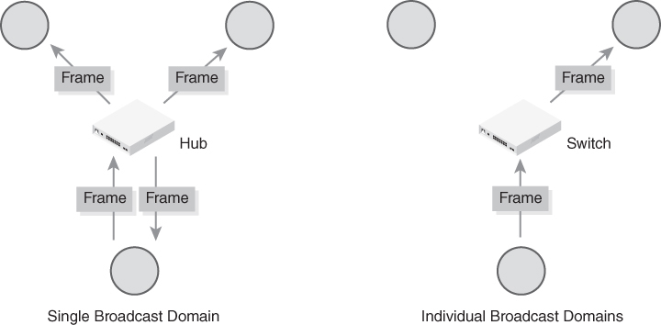
LAN Hub versus LAN Switch
FIGURE 3-19 LAN hub versus LAN switch.
Notes:
Hub – multiport broadcast domain in which each Ethernet frame and signal is transmitted through each physical port
Switch – multiport broadcast domain in which each physical port is its own Ethernet LAN segment

Slide 30
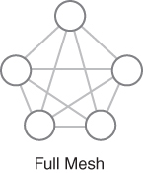
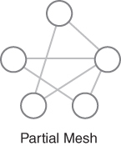
Mesh, Fully Connected Mesh, and Hybrid Topologies
Mesh topology
A network layout in which all nodes are directly connected to all other nodes
Hybrid topology
A network that contains several different topologies
Can provide fault tolerance for some nodes while providing flexibility for other parts of the network
FIGURE 3-20 Fully connected mesh.
FIGURE 3-21 Partially connected mesh.
Notes:
Fully connected mesh – high fault tolerance (drawback = # of connections)

Slide 31
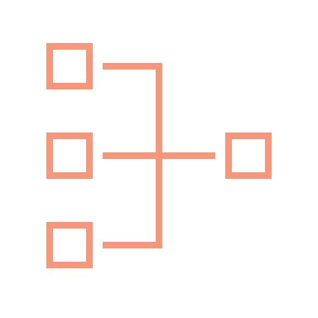
Internetworking
Internetworking is a term used to describe connecting LANs together
LANs communicate using protocols and the OSI model
Different network devices interoperate at different layers of the protocol stack
A protocol stack is how software operates at different layers of the OSI model
Internetworking LANs must follow the OSI model protocol stack definition
Thus, network devices must operate at either the Data Link Layer or the Network Layer
Notes:
Data link – 2
Device must be able to speak layer 2 language

Slide 32
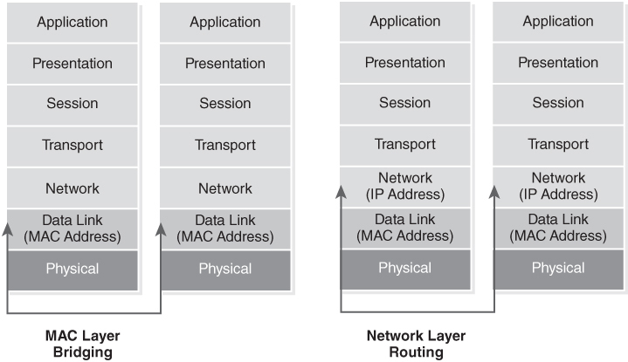
Internetworking at the Data Link Layer or Network Layer
FIGURE 3-22 Internetworking at the Data Link Layer or Network Layer.

Slide 33
Internetworking Terms (1 of 2)
Client/server architecture
Users interact with enterprise applications via local software running on client devices that use a network to connect to, and request services from, one or more servers
Depends on client/server internetworking
Peer-to-peer internetworking
The use of an enterprise network for peers to exchange messages without depending on a central server to manage connections or message handling
Most of today’s digital networks can support client/server and peer-to-peer communications
Notes:
1. Clearpass (where server OS is in datacenter and user requests everyday)

Slide 34
Internetworking Terms (2 of 2)
Intranet
An internal network that only employees can access
A private network within that organization’s IP network infrastructure
Extranet
A remotely accessible network that an organization makes accessible to its business partners and suppliers through the public Internet

Slide 35
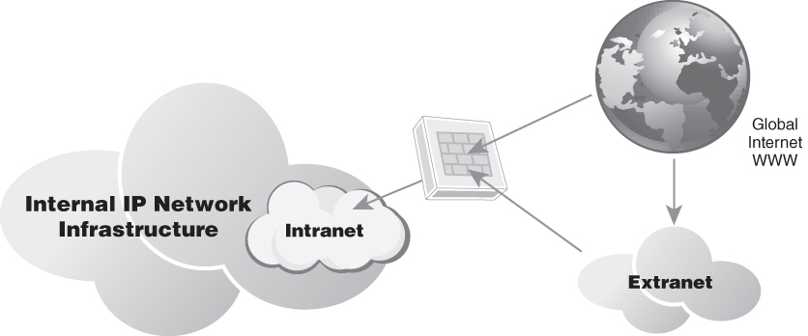
Intranets and Extranets
FIGURE 3-23 Intranets and extranets.

Slide 36

Internetworking with Bridges
Internetworking at the Data Link Layer requires a bridge
Easiest way to interconnect two networks is to place a MAC layer bridge in between the two networks
Bridge
Examines the MAC address of each frame received
Makes a filtering or forwarding decision based on the MAC address forwarding table
Notes:
Network bridge – device w/ 2 network interface cards so that it can connect to both networks

Slide 37
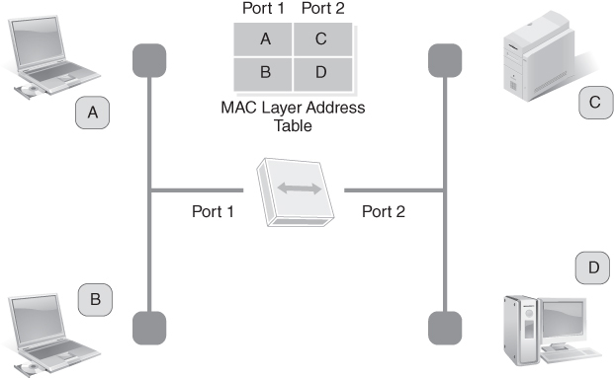
MAC Address Forwarding Table
FIGURE 3-24 MAC address forwarding table.

Slide 38
Internetworking with Switches (1 of 2)
Switch
Is essentially a bridge with more than two ports
Often has the capability to connect many devices and networks; a bridge generally connects two networks
Operates as an OSI Layer 2 device
Uses MAC addresses and builds address tables of devices connected to each physical port
Switches that connect multiple devices or networks keep track of Media Access Control (MAC) addresses on all ports
When the switch sees an Ethernet frame destined for a specific MAC address, it forwards that frame to that port

Slide 39
Internetworking with Switches (2 of 2)
Layer 2 switches
Operate at the Data Link Layer
Examine the MAC layer addresses of Ethernet frames
Layer 3 switches
Operate at either the Data Link Layer or Network Layer
Typically have software that lets them function like Layer 2 switches or multiport bridges
Usually operate at the Network Layer that examines the network layer address within the Ethernet frame
Can look up the destination IP network number in their IP routing tables, and then make a path determination decision

Slide 40
Internetworking with Routers
Router
Operates at the Network Layer
Is the same thing as a Layer 3 switch, but is typically used for WAN circuit connections, campus backbone connections, and building backbone connections
Can make intelligent decisions on where to send packets
Instead of just reading the MAC address and forwarding a packet based on a forwarding table, can see the packet’s Network Layer address or IP address
Network Layer address contains information about the destination network number and host number
Performs a path determination calculation to find the best path for the IP packets to traverse
Typically has redundant processors and plenty of memory
Takes longer to examine a packet than for a Layer 2 switch or bridge

Slide 41
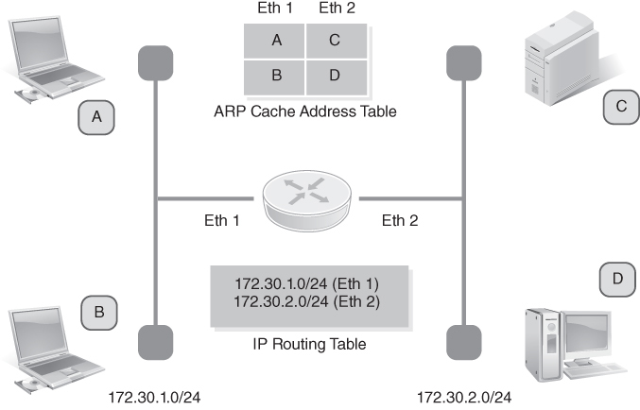
Router ARP Cache Table and IP Routing Table
FIGURE 3-25 Router ARP cache table and IP routing table.

Slide 42
Internetworking with a Bridge/Router
Routers can examine packets only in formats they understand
All network nodes must use protocols the routers understand; can cause challenges
Nonroutable protocol does not have a Network Layer address; routable protocol has a Network Layer address that is routable
Brouter
A device that can act as a bridge or router
Is the same thing as a Layer 3 switch with Layer 2 bridging software
Bridges Ethernet frames that are nonroutable and will route IP packets that are routable
Is a more flexible and powerful internetworking device for networks, given that it can interconnect LANs at the Data Link Layer or Network Layer

Slide 43
Internetworking with a Gateway
Interconnects two networks that use different protocols
Translates network packets from one network protocol to another (unlike a brouter)
Main job is to translate all incoming packets to a protocol compatible with the destination network
Is commonly placed at entry and exit points of a network
Commonly runs either as software on a computer or as a device that performs the same functions as a router

Slide 44
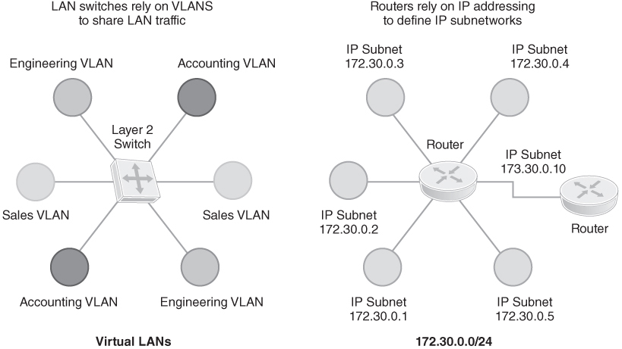
Switching Concepts
FIGURE 3-26 Physical versus logical network segmentation.
Notes:
Switching subdivides a network into multiple small networks.
The bridge or switch only sends packets to their destination network segment, so they can help reduce overall traffic and collisions.
You will only reduce overall congestion with a good network design and proper network segmentation.
A bridge or switch that forwards almost all traffic is not optimal.
The bridge or switch can become a traffic bottleneck with traffic entering buffer memory or traffic may be dropped.
It’s important to monitor network traffic, perform capacity planning, and provide for network growth and expansion.

Slide 45
Switch Functionality
Layer 2 versus Layer 3 workstation connectivity
MAC addressing tables
Forwarding/ filtering
Preventing broadcast storms caused by loops
Power over Ethernet (PoE) switch ports
Virtual LANs (VLANs)
Layer 2 or Layer 3 switch resiliency

Slide 46
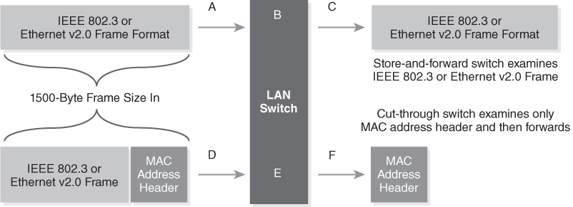
Forwarding Methods
FIGURE 3-27 Forwarding methods.

Slide 47
Switch Forwarding Methods
Cut-through switching
As LAN switch reads the destination MAC address, it starts to forward the packet to the destination and does not examine the entire frame
Increases network throughput and performance
Store-and-forward switching
LAN switches must receive the entire Ethernet frame and make forwarding decision based on MAC address table
Device can drop any packets with errors prior to forwarding them
Uses less of a network’s capacity but increases latency
Notes:
Store-and-forward switching
Uses less of a network’s capacity because it never forwards partial Ethernet frames
Increases latency due to the time required to collect the entire Ethernet frame

Slide 48
Routing Concepts
Network layer address
Static route
Dynamic route
Notes:
IP address (since it’s used by layer 3 devices)
Specific rule that defines how to handle specific network packets
A path to a destination that is discovered at runtime, not previously defined

Slide 49
Resiliency and Redundancy
Layer 2 Resiliency
Enabling resiliency protocols, such as Spanning Tree Protocol (STP) and Resilient Ethernet Protocol (REP), to avoid network communication interruptions
Layer 3 Resiliency
Supporting alternate routes to a WAN when the primary route is unavailable
Virtual Networking Components
Implementing some network devices as virtual machines (VMs) or containers, or building entire virtualized networks
Network Storage Types
Implementing network storage devices as VMs; storage area networks and network attached storage
Example: Cisco Hot Standby Routing Protocol (HSRP)
Notes:
Network storage types – SAN (storage area network), NAS (network attached storage)

Slide 50
Summary
The OSI and TCP/IP Reference Models
TCP/IP suite
Network topologies
Circuit and packet switching
IP-based communications and convergence

